Slide 1
Software process models
-Goutham

Slide 2
Table of contents
01
02
03
04
05
06
Introduction
Software process model
Process iteration
Process activities
The Rational Unified Process (RUP)
Financial & metrics

Slide 3

01
Introduction

Slide 4
Software process
Software process model
A software process is the set of activities and associated results that produce a software product
A software process model is a simplified description of a software process that presents one view of that process

Slide 5

02
Software process models

Slide 6
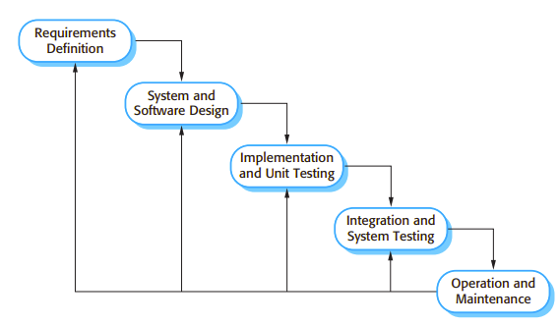
Water fall model
This takes the activities and represents them as separate process phases such as requirements specification, software design, implementation, testing and so on. After each stage is defined it is 'signed-off, and development goes on to the following stage.
This is also called software life cycle model.
Waterfall is great when the goal is clear and fixed.

Slide 7
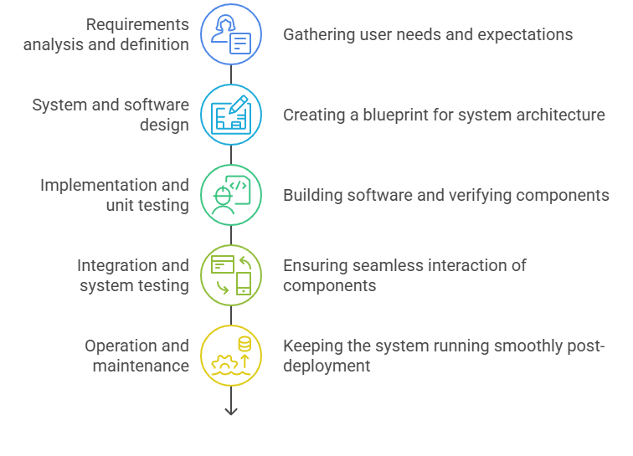
Phases of software development life cycle

Slide 8
Case study
WhatsApp Web (Initial Launch)
Parent App:
WhatsApp Messenger
Project Goal:
Extend WhatsApp to desktops via
browsers without compromising mobile-linked
security or performance.

Slide 9
Requirements analysis and definition
Requirement ID | Description
FR-1 | The system shall allow two users (client and server) to exchange text messages in real time.
FR-2 | The system shall support bidirectional (two-way) communication.
FR-3 | The server shall listen for incoming connections on a specific IP and port.
FR-4 | The client shall connect to the server using a valid host and port.
FR-5 | Both client and server shall be able to send and receive messages simultaneously (via threading).
FR-6 | The system shall support termination of the chat session with the keyword exit.
FR-7 | The chat history shall be stored in a file (chat_log.txt) on the server.
FR-8 | The client shall simulate a login using a QR code input (simplified as text input).

Slide 10



System and software design
messages
TCP/IP
TCP/IP
Client1
Send / Receive
Client2
Send / Receive
System design
Software design(UI/UX)

Slide 11
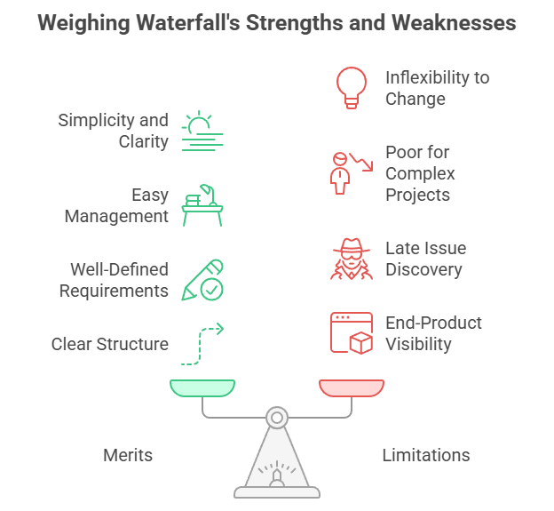

Slide 12
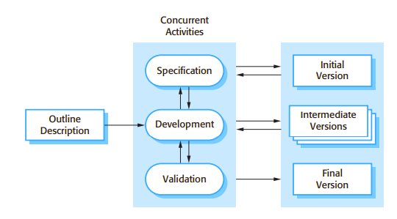
Evolutionary model
It is based on the idea of developing an initial implementation, exposing this to user comment and evolving it through several versions until an adequate system has been developed Specification, development and validation activities are interleaved rather than separate, with rapid feedback across activities. Also called iterative development, Incremental development

Slide 13
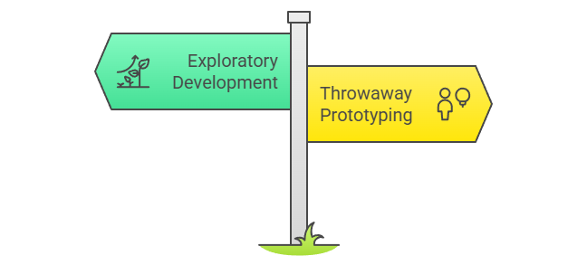
Type of evolutionary model
The the objective of the evolutionary development process is to understand the customer's requirements and hence develop a better requirements definition for the system. The prototype concentrates on experimenting with the customer requirements that are poorly understood.
The objective of the process is to work with the customer to explore their requirements and deliver a final system. The development starts with the parts of the system that are understood. The system evolves by adding new features proposed by the customer.

Slide 14
Advantages
The specification can be developed incrementally. As users develop a better understanding of their problem, this can be reflected in the software system
Disadvantages
The process is not visible Managers need regular deliverables to measure progress. If systems are developed quickly, it is not cost-effective to produce documents that reflect every version of the system.
Systems are often poorly structured Continual change tends to corrupt the software structure. Incorporating software changes becomes increasingly difficult and costly.

Slide 15
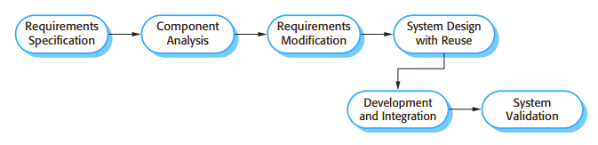
Component Based Software Engineering (CBSE)
Also known as component-based development (CBD), Reuse-oriented software engineering (ROSE) is a process that focuses on the systematic reuse of independently developed software units called components to build software systems. These components can be bought off-the-shelf (COTS – Commercial Off-The-Shelf), internally developed, or open-source.

Slide 16
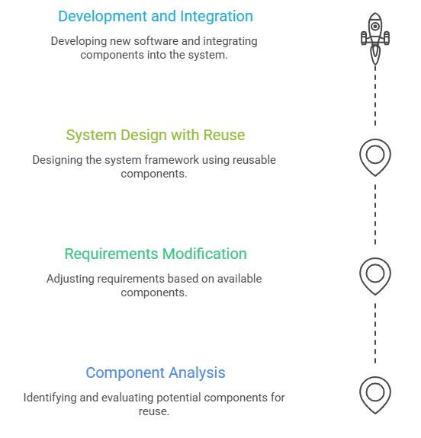
Stages of CBSE
4
3
2
1

Slide 17
Case study
Telegram wants to introduce a real-time location
sharing feature

Slide 18
Component analysis
Given the requirements specification, a search is made for components to implement that specification.
The initial step is to identify reusable components that support:
Map display (Google Maps SDK, OpenStreetMap)
GPS location tracking APIs (Android LocationManager or iOS Core Location)
Backend support for data transmission
Existing user permissions component for location
Since no single component provides the full functionality, Telegram identifies several partial matches like:
Google Maps for rendering
Platform-native location tracking API
Their existing messaging infrastructure for peer-to-peer updates

Slide 19
Requirements Modification
Requirements are analyzed using info about discovered components and modified to reflect available components
The initial requirement may have been: Share live location with exact geofencing and speed display.
After analyzing available components:
Geofencing support may be limited across platforms.
Real-time speed tracking is inconsistent.
So, Telegram modifies the requirements to:
Share approximate location every 15 seconds.
Use built-in GPS update intervals.
Display location with a user-friendly map marker.
Thus, requirements are adapted to fit existing component capabilities.

Slide 20
System Design with Reuse
Framework of the system is designed, considering the reused components.
Telegram's system is architected such that:
A modular Location Sharing component is created.
Google Maps SDK is integrated into the UI layer.
GPS APIs are abstracted so platform-specific differences are hidden.
A Location Update Service runs in the background to push coordinates via existing message queues.
Any new code needed is developed to fill the gaps such as:
A wrapper around GPS APIs
A timestamped protocol for transmitting coordinates
Custom UI elements for rendering avatars on map

Slide 21
Development and Integration
Develop software not available externally, and integrate with existing and third-party components
Telegram develops any missing logic:
ex: backend location push notification, error handling, and user settings.
Integrates:
Native location services (Android/iOS)
Google Maps
Their custom real-time messaging protocol
All components are assembled into a cohesive feature.
System testing ensures:
Location updates are accurate
Battery usage is optimized
Privacy permissions (like revoking location access) work properly

Slide 22
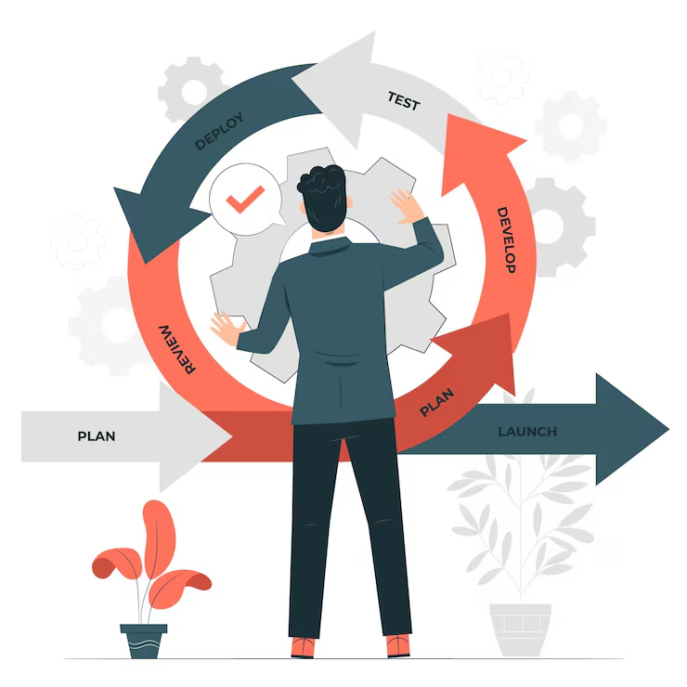
03
Process Iteration

Slide 23
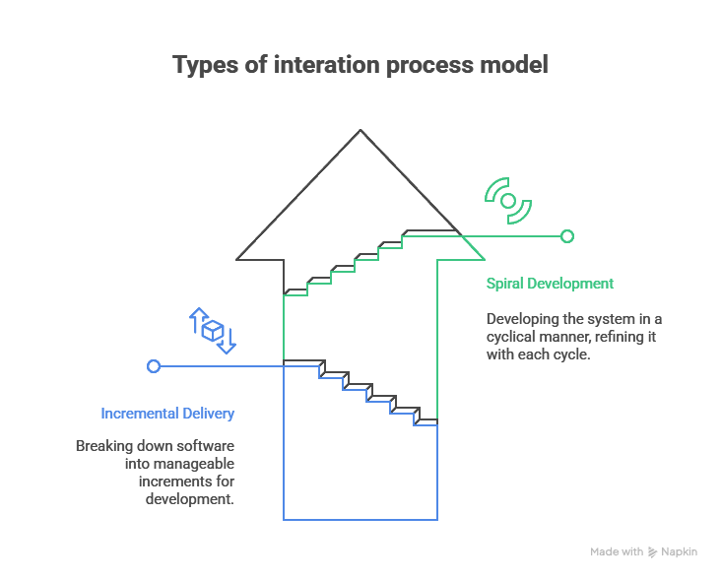
Here the specification is developed in conjunction with the software. However, this conflicts with the procurement model of many organizations where the complete system specification is part of the system development contract. In incremental approach, there is no complete system specification until the final increment is specified.

Slide 24
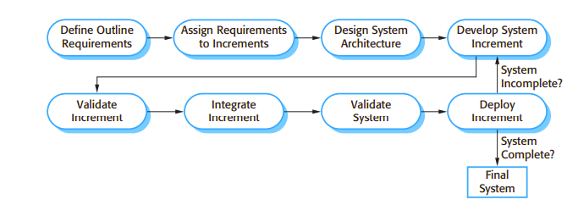
Incremental delivery
Here customers identify, in outline, the services to be provided by the system. They identify which of the services are most important and which are least important to them. A number of delivery increments are then defined, with each increment providing a sub-set of the system functionality.
The allocation of services to increments depends on the service priority, with the highest-priority services implemented and delivered first. Once the system increments have been identified, the requirements for the services to be delivered in the first increment are defined in detail and that increment is developed.
During development, further requirements analysis for later increments can take place but requirements changes for the current increment are not accepted. Once an increment is completed and delivered, customers can put it into service.
This means that they take early delivery of part of the system functionality. They can experiment with the system and this helps them clarify their requirements for later system increments. As new increments are completed, they are integrated with existing increments so that the system functionality improves with each delivered increment.

Slide 25
Case study
Developing WhatsApp from scratch

Slide 26
Increment 1:
Core Messaging Functionality
Features Delivered:
User registration with phone number
Send/receive text messages
Contact list from phone
User can: Register and chat with friends
Tested: Text-based messaging only
Increment 2:
Media Sharing
New Features Added:
Send/receive images and videos
Camera access
Media compression and upload
User can: Share photos from gallery or directly using camera
Tested: Media file size limits, compatibility across devices
Increment 3:
Voice Messaging
New Features Added:
Record and send voice messages
Playback controls (play, pause, seek)
User can: Use push-to-talk voice messages
Tested: Background noise handling,
audio quality
Increment 4:
Group Chats
New Features Added:
Create group chats
Add/remove participants
Group notifications and settings
User can: Chat with multiple users in one thread
Tested: Scalability of group size, notifications

Slide 27
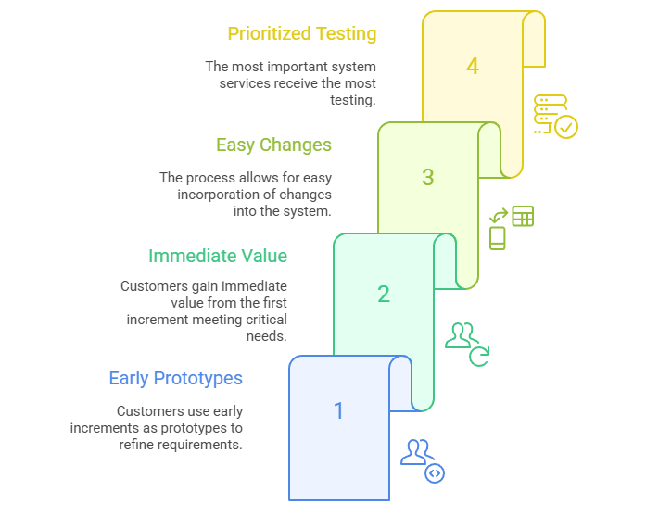
Advantages

Slide 28
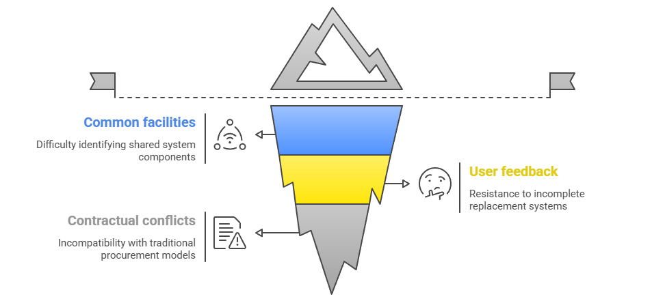
Disadvantages

Slide 29
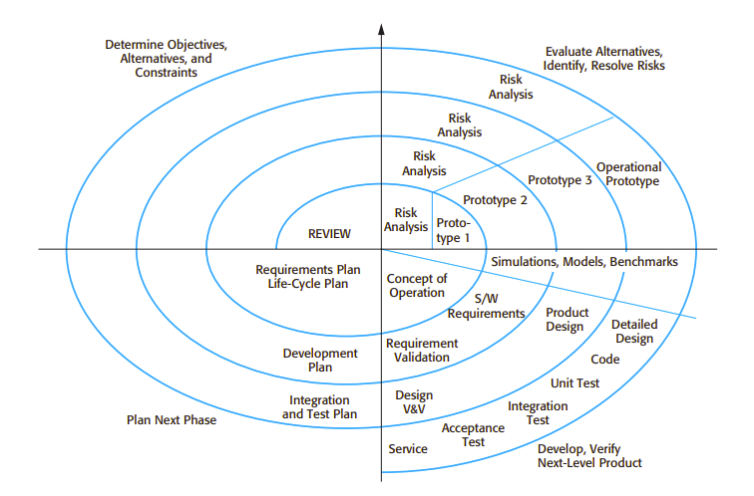
Spiral model
This process model proposed by Barry Boehm in 1986. It’s designed to manage risk and accommodate change efficiently by combining the iterative nature of prototyping with the systematic aspects of the waterfall model.

Slide 30
4 sectors of single spiral
Objective setting Specific objectives for that phase of the project are defined. Constraints on the process and the product are identified and a detailed management plan is drawn up. Project risks are identified. Alternative strategies, depending on these risks, may be planned.
Risk assessment and reduction For each of the identified project risks, a detailed analysis is carried out. Steps are taken to reduce the risk. For example, if there is a risk that the requirements are inappropriate, a prototype system may be developed.
Development and validation After risk evaluation, a development model for the system is chosen. For example, throwaway prototyping may be the best development approach if user interface risks are dominant. If safety risks are the main consideration, development based on formal transformations may be the most appropriate process, and so on. If the main identified risk is sub-system integration, the waterfall model may be the best development model to use.
Planning The project is reviewed and a decision made whether to continue with a further loop of the spiral. If it is decided to continue, plans are drawn up for the next phase of the project.

Slide 31
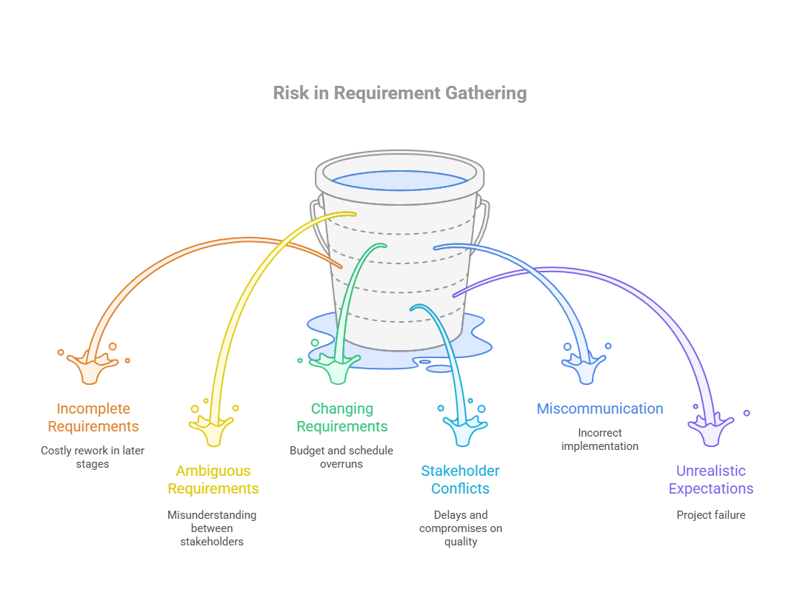

Slide 32
Risk | Cause | Impact | Mitigation Strategy
Incomplete requirements | Missed stakeholder input | Missing features | Conduct comprehensive stakeholder interviews, use requirement checklists, and hold requirement review sessions with all parties.
Ambiguous requirements | Vague wording | Misinterpretation | Use clear, measurable, testable statements (per IEEE SRS guidelines) and maintain a glossary of terms.
Scope creep | Uncontrolled change requests | Budget/schedule overruns | Implement a formal change control process; evaluate and approve changes before adding to scope.
Stakeholder conflicts | Differing priorities | Delays, compromise quality | Facilitate requirements negotiation workshops and maintain a prioritized requirement list agreed by all stakeholders.
Miscommunication | Terminology mismatch | Wrong implementation | Use visual models (UML, DFD), maintain documentation in a shared repository, and conduct regular review meetings.
Ignoring non-functional reqs | Focus only on functional requirements | Poor system performance | Include non-functional requirements in SRS (e.g., performance, security, usability) and plan separate tests for them.
Unrealistic expectations | Over-promising deliverables | Project failure | Involve technical leads in estimation, use historical data, and set SMART goals with clear deliverables.

Slide 33
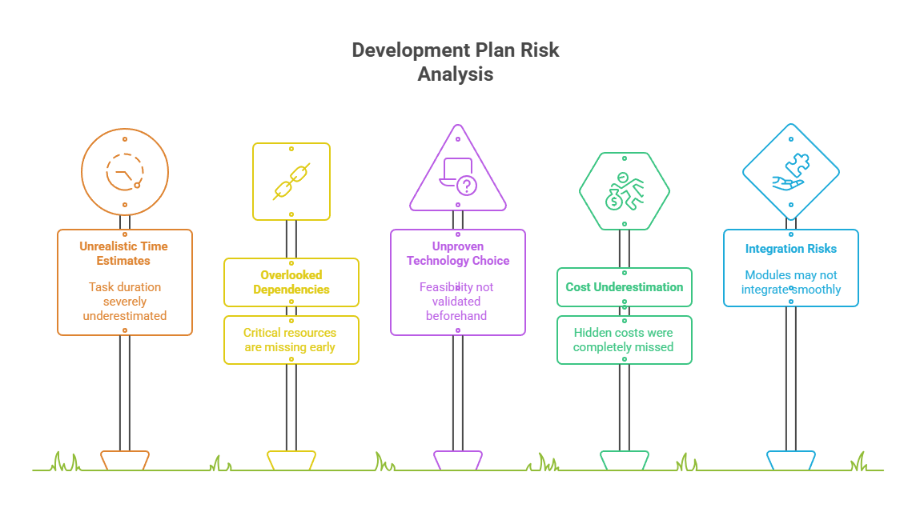

Slide 34
Risk | Description | Example | Impact | Mitigation
Unrealistic Time Estimates | Underestimating duration for tasks | Planning 2 weeks for integration when testing alone takes 3 weeks | Schedule slippage | Use historical data, add buffer
Overlooked Dependencies | Missing resource/tool dependencies in the plan | Ignoring that UI team needs backend API ready first | Blocked tasks | Use dependency mapping in Gantt charts
Unproven Technology Choice | Selecting tools without validating feasibility | Choosing a new AI library without pilot test | Technical delays, rework | Do prototype or proof-of-concept
Resource Constraints | Not enough skilled staff for planned tasks | Planning 4 modules in parallel but only 2 developers available | Bottlenecks, quality drop | Adjust plan or hire/train
Cost Underestimation | Budget plan misses hidden costs | Ignoring licensing fees for third-party SDK | Budget overruns | Cost analysis with contingency fund
Scope Misalignment | Planned tasks don’t match evolving requirements | Working on old feature set while client updated needs | Wasted effort | Sync plan with latest requirement document
Integration Risks | Planned modules may not integrate smoothly later | Different spirals use incompatible data formats | Major rework | Define standards early, do integration testing mid-way

Slide 35
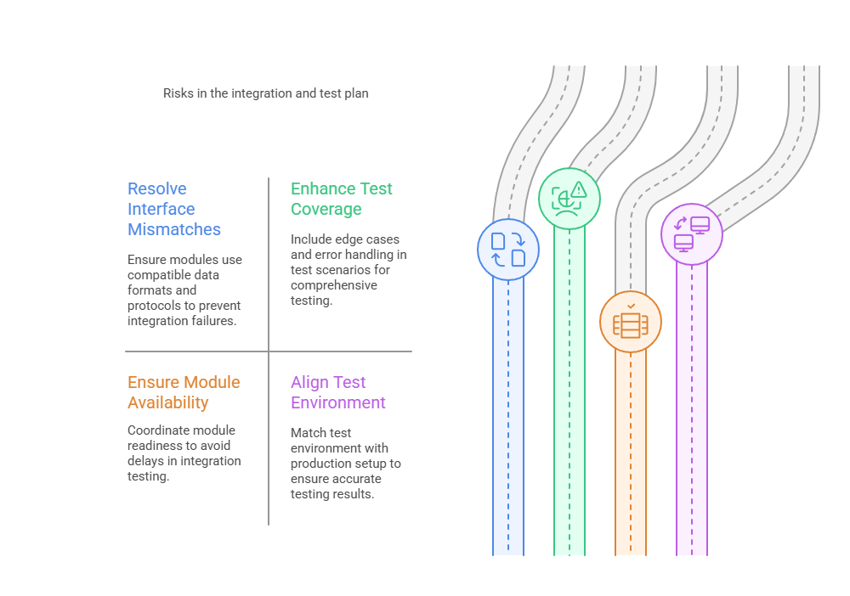

Slide 36

04
Process Activities

Slide 37
The four basic process activities of specification. development. validation and evolution are organized differently in different development processes.
In the waterfall they are organized in sequence, whereas in evolutionary development they are interleaved.
How these activities are carried out is depends on the type of software, people and organizational structures involved.
There is no right or wrong way to organize these activities

Slide 38
Software specification
Software specification or requirements engineering is the process of understanding and defining what services are required from the system and identifying the constraints on the system's operation and development
Requirements engineering is a particularly critical stage of the software process as errors at this stage inevitably lead to later problems in the system design and implementation.

Slide 39
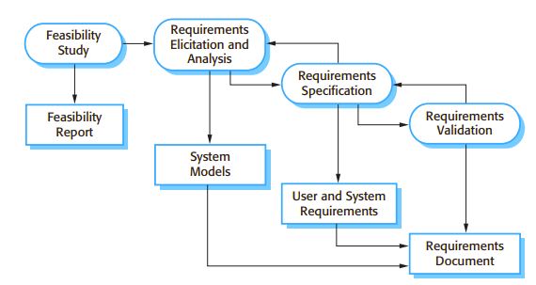
4 activities of Requirement Engineering

Slide 40
Feasibility study An estimate is made of whether the identified user needs may be satisfied using current software and hardware technologies. The study considers whether the proposed system will be cost-effective from a business point of view and if it can be developed within existing budgetary constraints. A feasibility study should be relatively cheap and quick. The result should inform the decision of whether or not to go ahead with a more detailed analysis.
Requirements elicitation and analysis This is the process of deriving the system requirements through observation of existing systems, discussions with potential users and procurers, task analysis, and so on. This may involve the development of one or more system models and prototypes. These help in understanding the system to be specified.

Slide 41
Requirements specification Requirements specification is the activity of translating the information gathered during the analysis activity into a document that defines a set of requirements. Two types of requirements may be included in this document. User requirements are abstract statements of the system requirements for the customer and end-user of the system; system requirements are a more detailed description of the functionality to be provided
Requirements validation This activity checks the requirements for realism, consistency, and completeness. During this process, errors in the requirements document are inevitably discovered. It must then be modified to correct these problems.

Slide 42
Case study
Developing UPI Payment app GPay

Slide 43
1. Feasibility Study
Goal: Determine whether it's technically and economically viable to build the application.
GPay Case:
Is it feasible to create a UPI-based payment system in India?
Can it integrate securely with banks and NPCI (National Payments Corporation of India)?
Is there a demand for digital wallets and UPI apps?
Output: Feasibility Report
Example: UPI integration is supported and there is market demand.

Slide 44
2. Requirements Elicitation and Analysis
Goal: Gather needs from stakeholders and analyze them.
GPay Case:
Interview users: What do they expect in a payment app?
Talk to banks: What APIs do they provide?
Talk to merchants: What payment options do they need?
Output: System Models
Example: Use cases like “Send money”, “Scan QR”, “Bank Account Linking”, “Cashback Offers”

Slide 45
3. Requirements Specification
Goal: Formally define and document the functional and non-functional requirements.
GPay Case:
Functional:
Users should be able to send money via UPI.
The app should show transaction history.
Non-functional:
App should process payments in <2 seconds.
Support biometric authentication.
Output: User and System Requirements

Slide 46
4. Requirements Validation
Goal: Ensure that the documented requirements accurately reflect what users and stakeholders want.
GPay Case:
Do users understand all features?
Is anything missing (e.g security alerts)?
Are all compliance aspects (e.g RBI guidelines) considered?
Example: Review meetings, simulations, prototyping.
Output: Validated Requirements

Slide 47
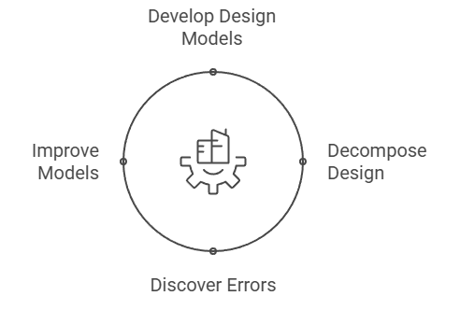
Software design and implementation
The implementation stage of software development is the process of converting a system specification into an executable system.
A software design is a description of the structure of the software to be implemented, the data which is part of the system, the interfaces between system components and, sometimes, the algorithms used.
The design process may involve developing several models of the system at different levels of abstraction. As a design is decomposed, errors and omissions in earlier stages are discovered. These feed back to allow earlier design models to be improved.
Design process activities are interleaved. Feedback from one stage to another and consequent design rework is inevitable in all. design processes.

Slide 48
specific design process activities
Requirements
Specification
Design activities
Architectural
design
Abstract
Specification
Interface
Design
Component
Design
Data Structure
Design
Algorithm
Design
System
architecture
Software
Specification
Interface
Specification
Component
Specification
Data
Structure
Specification
Algorithm
Specification
Design product

Slide 49
Let’s understand the specific design process activities with the example of ATM

Slide 50
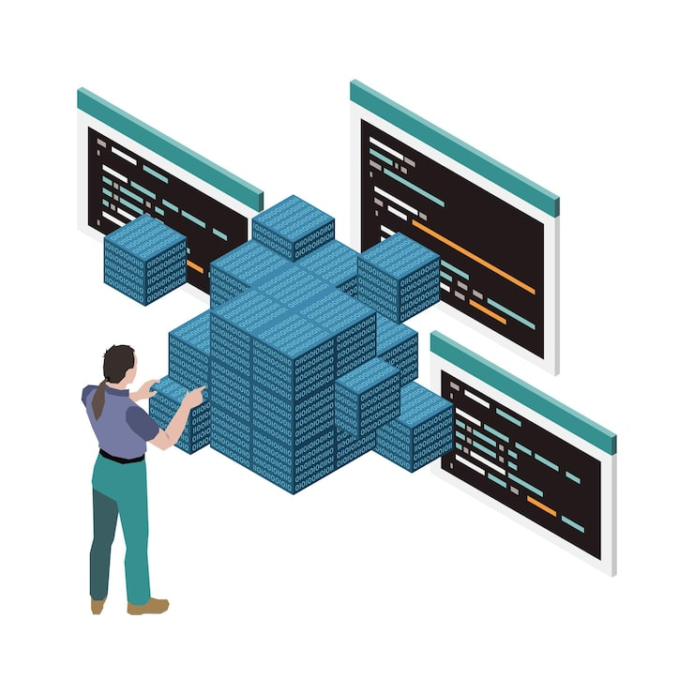
Architectural Design → System Architecture
The sub-systems making up the system and their relationships are identified and documented.
Defines the overall structure of the system, high-level components, and how they interact.
Example:
Components: ATM Terminal, Bank Server, Network
Communication Module, Database.
Architecture: Client-server model where ATM machines act as
clients connecting to the bank’s central server.

Slide 51
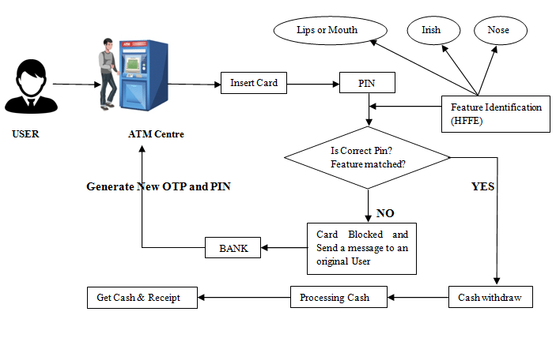
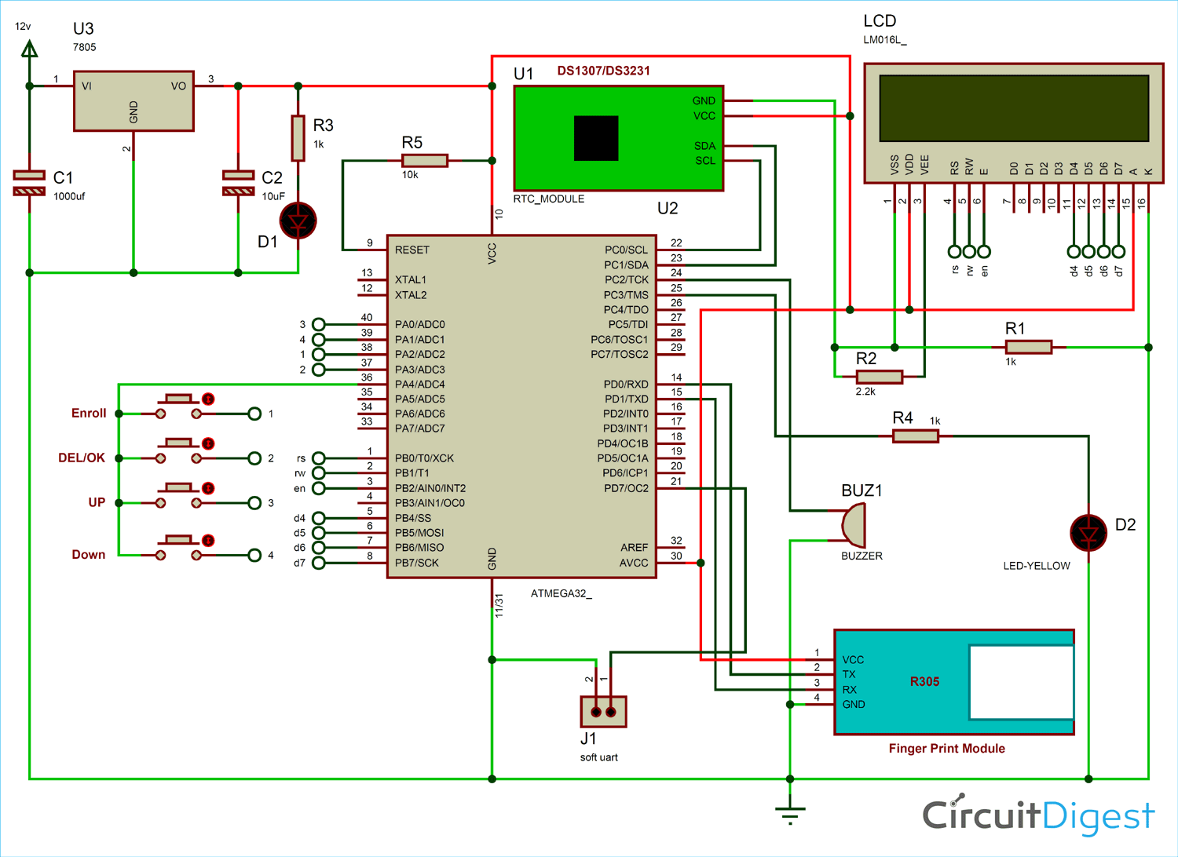

Slide 52
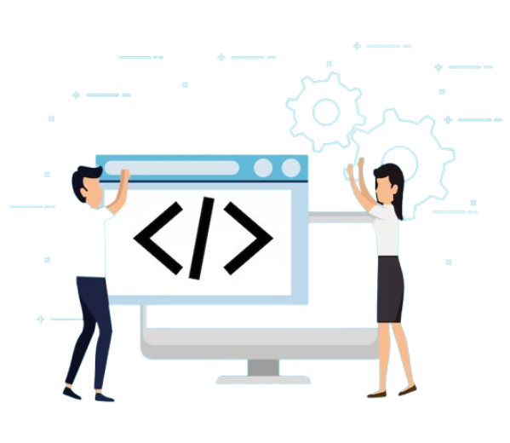
Abstract Specification → Software Specification
For each sub-system, an abstract specification of its services and the constraints under which it must operate is produced.
Defines the major software functions and how the system will behave without going into code-level details.
Example:
Software services: Authenticate user, process
withdrawals, check balances, deposit funds, transfer money.
Describes inputs/outputs for each function but not implementation details.

Slide 53
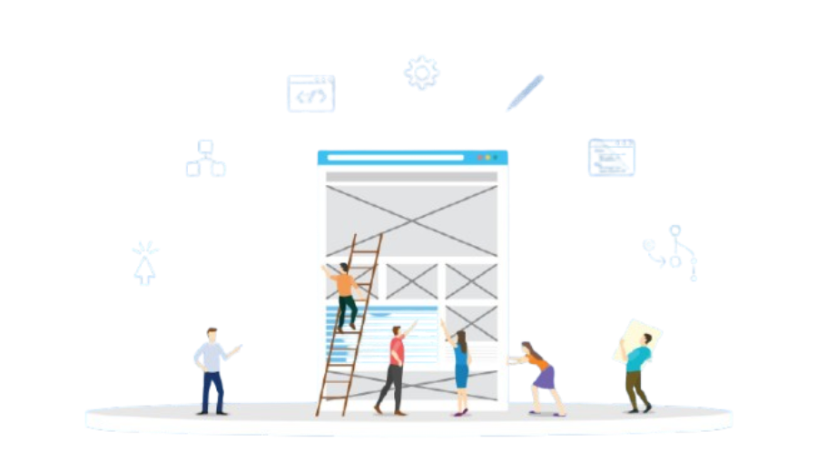
Interface Design → Interface Specification
For each sub-system, its interface with other sub-systems is designed and documented. This interface specification must be unambiguous as it allows the sub-system to be used without knowledge of the sub-system operation.
Designs how components interact with each other and with external systems/users.
Example:
User interface: Screen layouts for PIN entry, menu selection, transaction confirmation.
System interface: Protocol between ATM client and bank server (e.g., message format for balance inquiry).

Slide 54
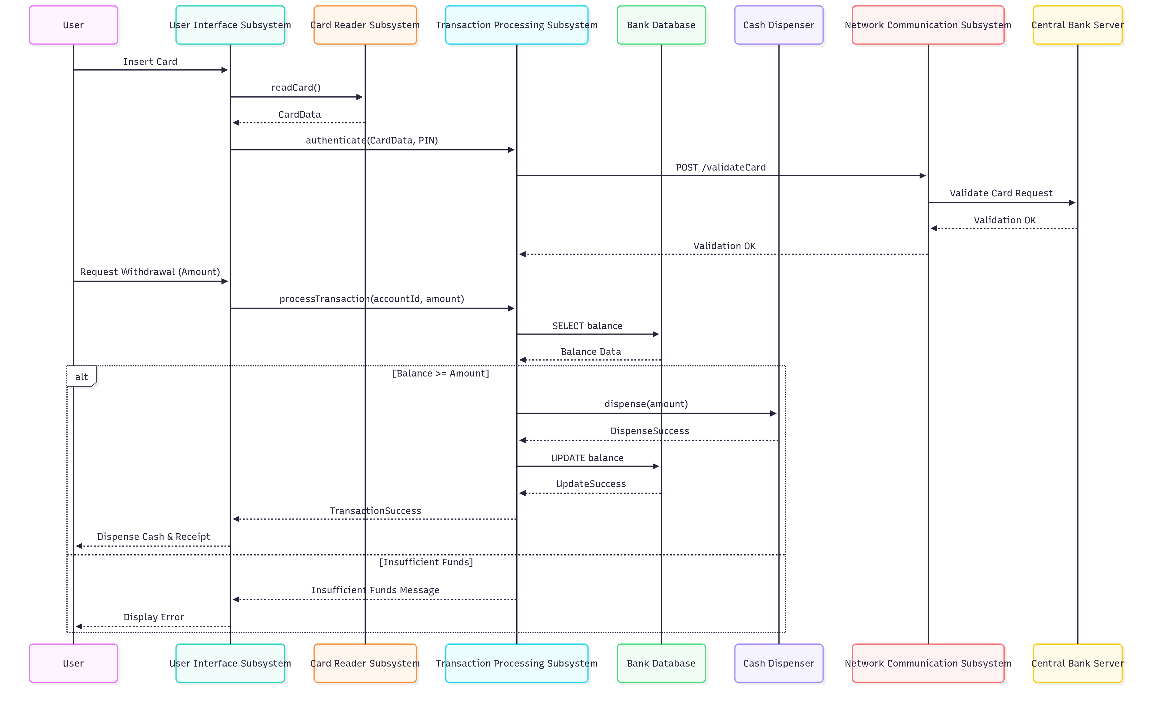

Slide 55
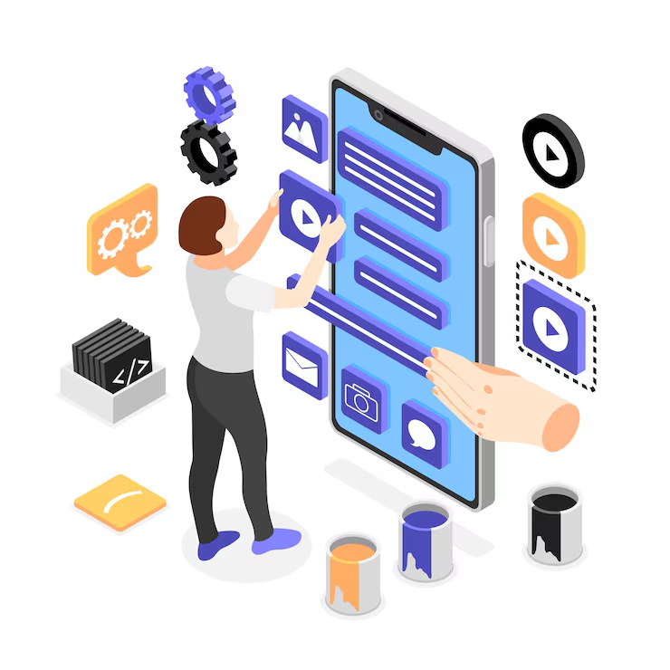
Component Design → Component Specification
Services are allocated to components and the interfaces of these components are designed.
Breaks down the system into smaller, detailed modules/components with clear responsibilities.
Example:
Components: Card reader controller, cash dispenser controller, receipt printer module, transaction processor module.
Specifies how each component will work internally and interact with others.

Slide 56
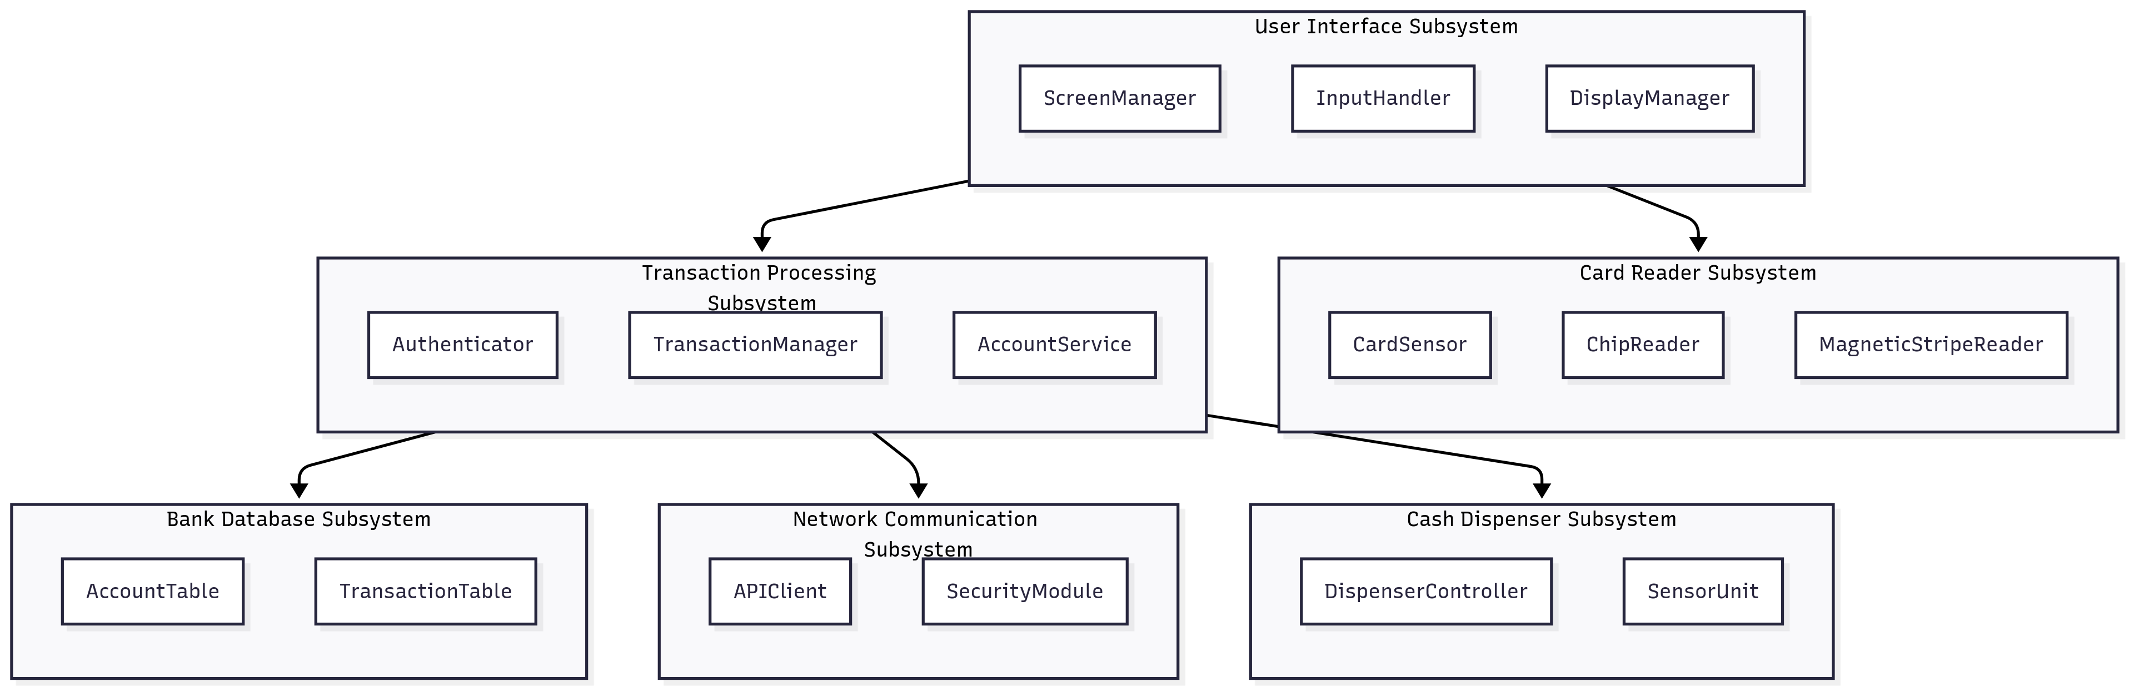

Slide 57
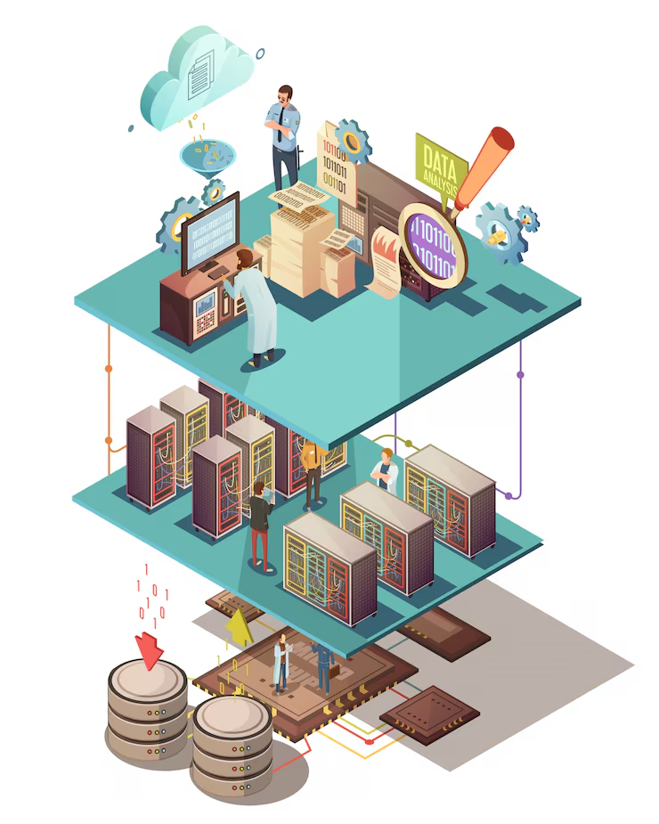
Data Structure Design → Data Structure Specification
The data structures used in the system implementation are designed in detail and specified.
Decides how data will be organized and stored in the system.
Example:
Data structures: Account records, transaction logs, customer profiles.
Defines structure fields (e.g., account number, balance, PIN hash).

Slide 58
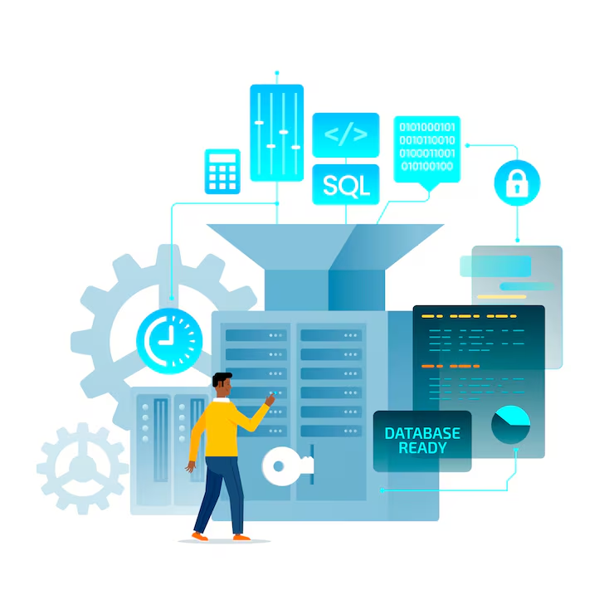
Algorithm Design → Algorithm Specification
The algorithms used to provide services are designed in detail and specified.
Defines step-by-step logic for functions in the system.
Example:
PIN verification algorithm.
Cash withdrawal process:
Check balance.
Deduct requested amount.
Update database.
Trigger cash dispenser.

Slide 59
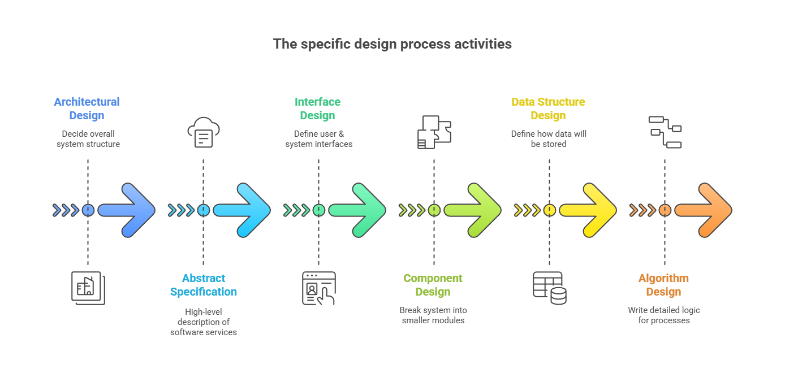

Slide 60

05
The Rational Unified Process

Slide 61
The Rational Unified Process (RUP) (Krutchen, 2003) is an example of a modern process model that has been derived from work on the UML and the associated Unified Software Development Process.
Hybrid process model as it brings together elements from all of the generic process models.
Its mainly used for object-oriented programming

Slide 62
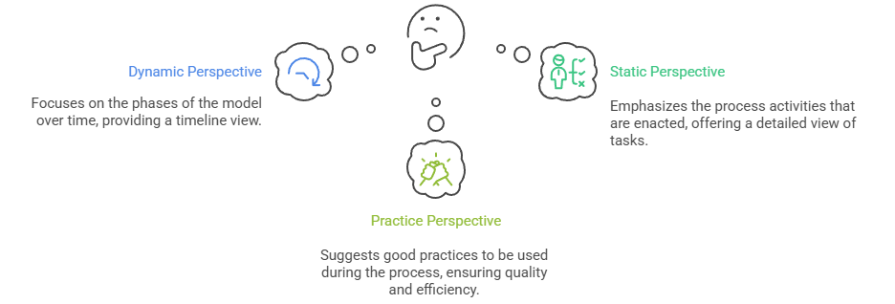
RUP is normally described from three perspectives:

Slide 63
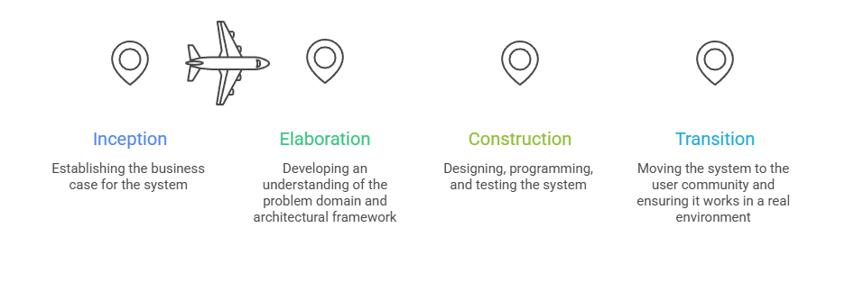
4 phases of RUP

Slide 64
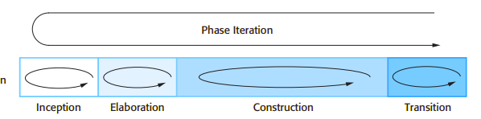
Inception :
The goal of the inception phase is to establish a business case for the system. You should identify all external entities (people and systems) that will interact with the system and define these interactions. You then use this information to assess the contribution that the system makes to the business. If this contribution is minor, then the project may be cancelled after this phase.
Elaboration:
The goals of the elaboration phase are to develop an understanding of the problem domain, establish an architectural framework for the system, develop the project plan, and identify key project risks. On completion of this phase, you should have a requirements model for the system, which may be a set of UML use-cases, an architectural description, and a development plan for the software.

Slide 65
Construction:
The construction phase involves system design, programming, and testing. Parts of the system are developed in parallel and integrated during this phase. On completion of this phase, you should have a working software system and associated documentation that is ready for delivery to users.
Transition:
The final phase of the RUP is concerned with moving the system from the development community to the user community and making it work in a real environment. This is something that is ignored in most software process models but is, in fact, an expensive and sometimes problematic activity. On completion of this phase, you should have a documented software system that is working correctly in its operational environment.

Slide 66
RUP
PHASES Inception Elaboration Construction Transition
-----------------------------------------------------------------------------------------------------------------------------------
Requirements ██████ █
Design █████ ██████████ █
Implementation ████ ███████████████ ███
Testing ██ █████████ █████████
Deployment ██ ███████
----------------------------------------------------------------------------------------------------------------------------------

Slide 67
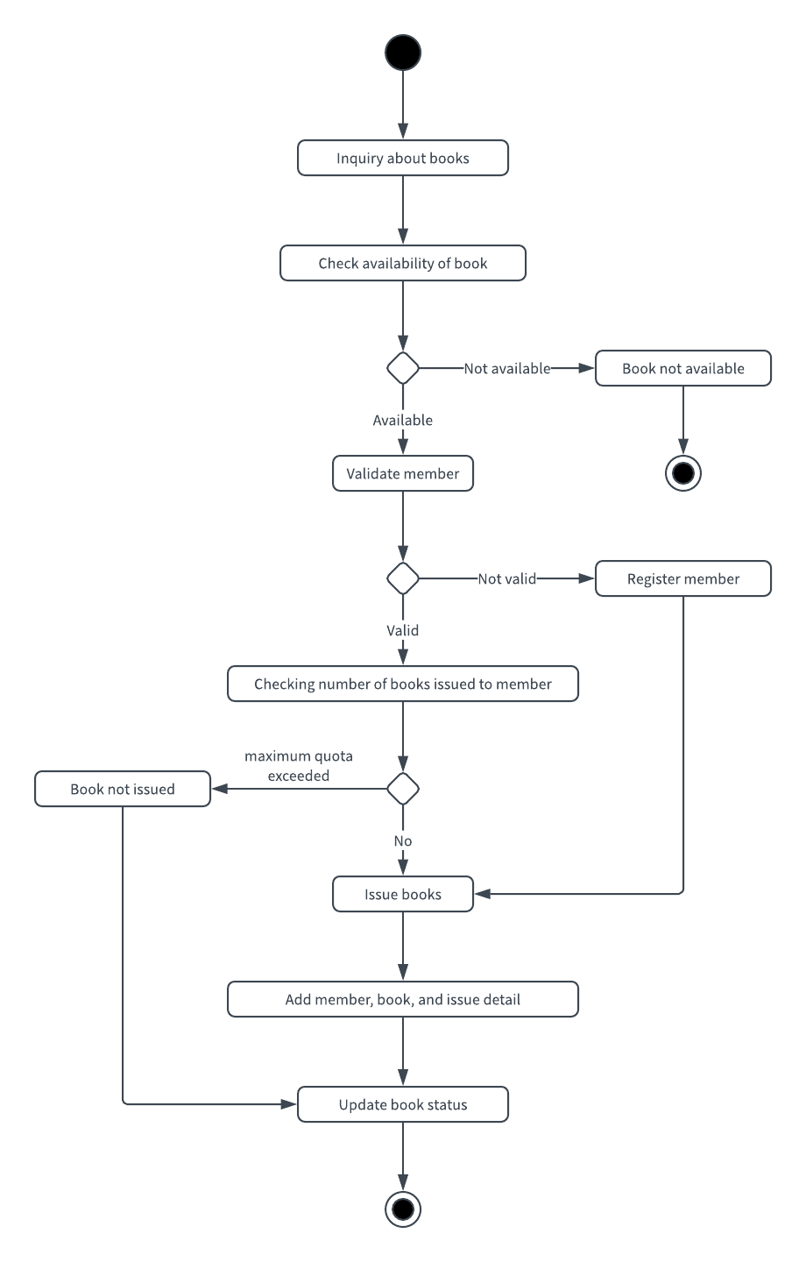
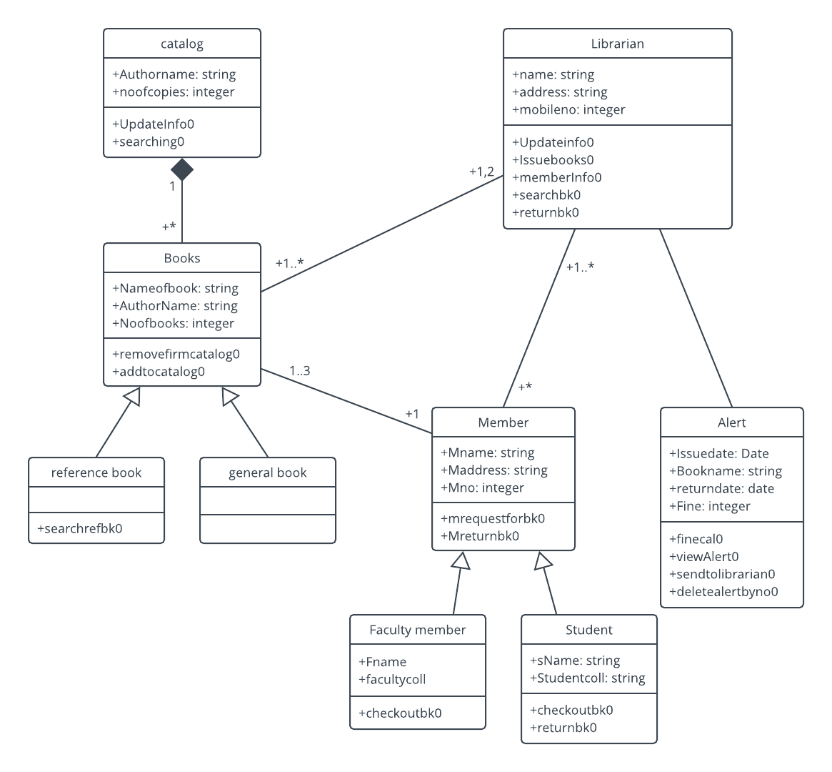

Slide 68
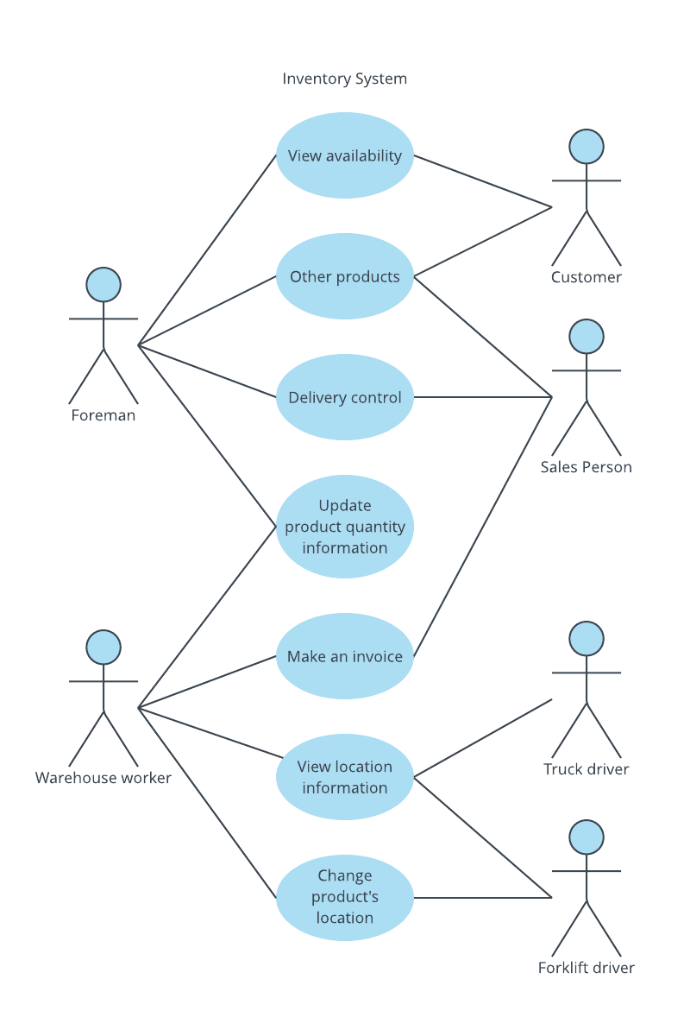
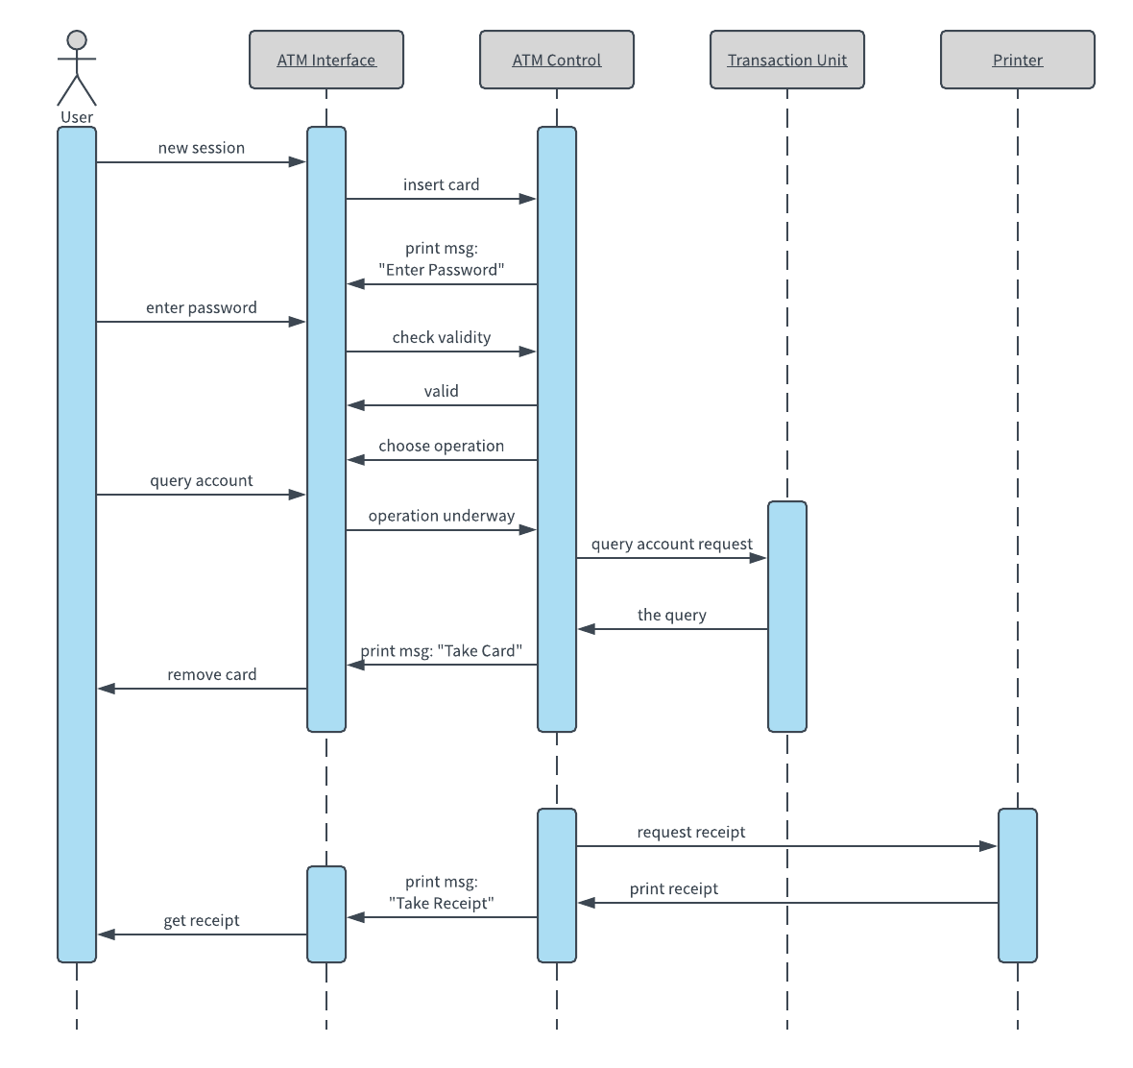

Slide 69
End of chapter

